Slide 1
Time Series: Unit 5
MA and ARMA!

Slide 2
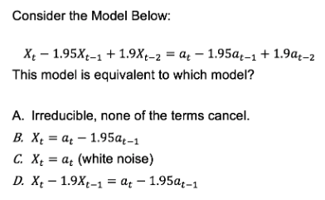
Cleaning Up Some Loose Ends

Slide 3
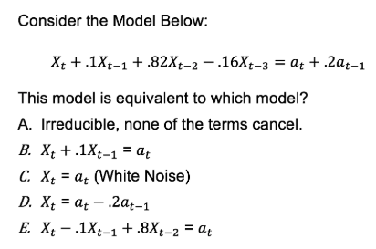
Cleaning Up Some Loose Ends

Slide 4
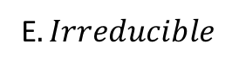
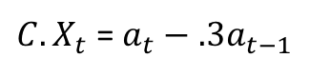
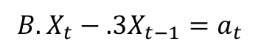
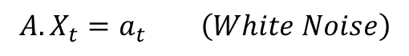
Cleaning Up Some Loose Ends
$$X_{t}−.5X_{t−1}−.44X_{t−2}+.15X_{t−3}=a_{t}−.3a_{t−1}$$
$$A.X_{t}=a_{t} \left(White Noise\right)$$
$$B.X_{t}−.3X_{t−1}=a_{t}$$
$C.X_{t}$ = $a_{t}−.3a_{t−1}$
$$D. \left(X_{t}−.8141X_{t−1}\right)\left(X_{t}+.6141X_{t−1}\right)=a_{t}$$
E$. Irreducible$

Slide 5
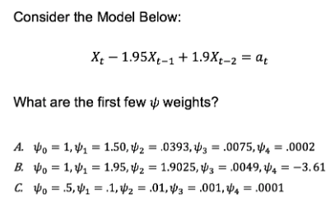
Cleaning Up Some Loose Ends:

Slide 6
Break Out 1

Slide 7
1. AIC5 for Store 8: Item 1
Review and describe your findings with respect to the AIC and the model identification for the realization you chose.

Slide 8
End Break Out 1

Slide 9
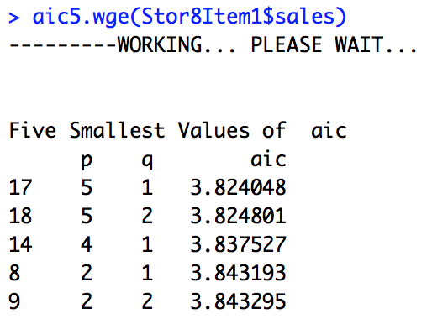
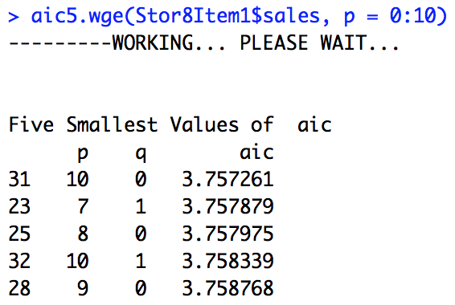
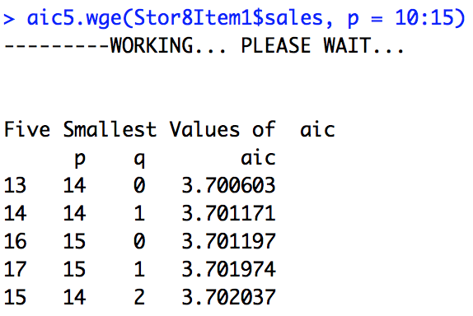
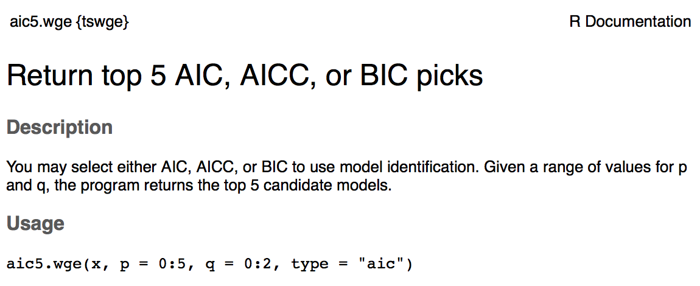
1. AIC5 for Store 8: Item 1

Slide 10
Break Out 2

Slide 11

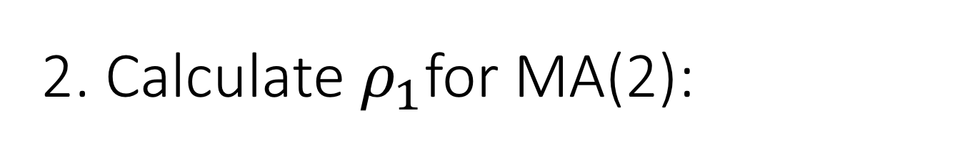
2. Calculate $ρ_{1}$for MA(2):
$$X_{t}=a_{t}−.8a_{t−1}+.5a_{t−2}$$

Slide 12
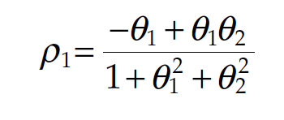
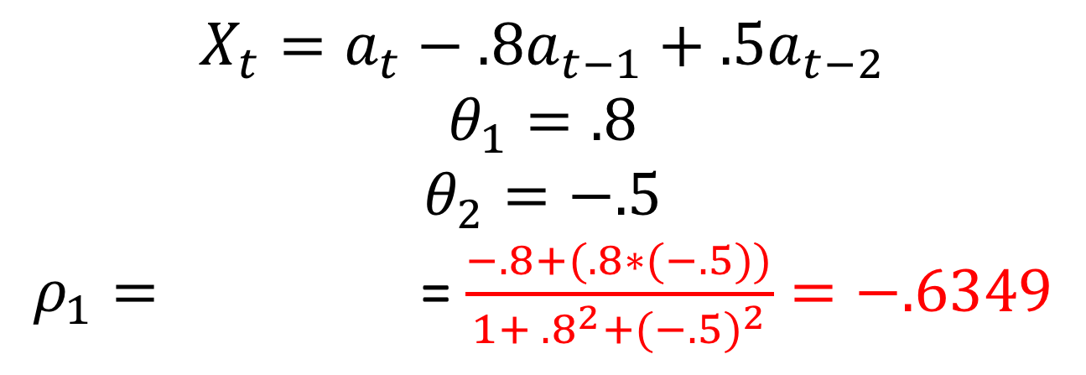
2. Calculate $ρ_{1}$for MA(2):
$$X_{t}=a_{t}−.8a_{t−1}+.5a_{t−2}$$
$$θ_{1}=.8$$
$$θ_{2}=−.5$$
$ρ_{1}=$ = $\frac{−.8+(.8∗(−.5))}{1+ {.8}^{2}+{(−.5)}^{2}}=−.6349$

Slide 13
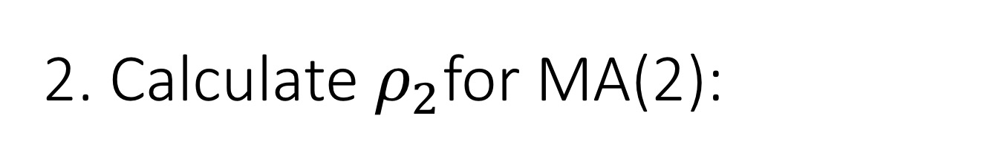
2. Calculate $ρ_{2}$for MA(2):
$$X_{t}=a_{t}−.8a_{t−1}+.5a_{t−2}$$

Slide 14
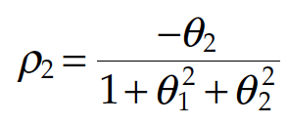
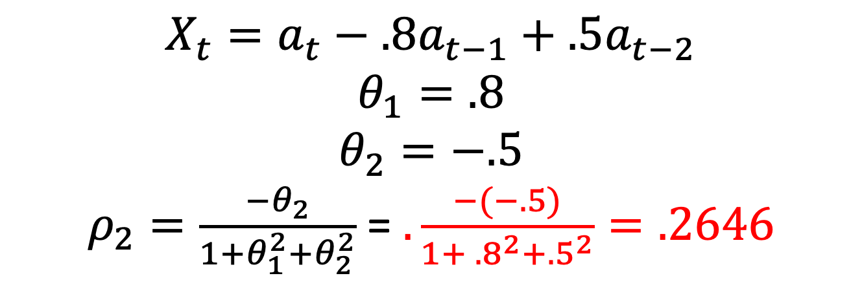
2. Calculate $ρ_{2}$for MA(2):
$$X_{t}=a_{t}−.8a_{t−1}+.5a_{t−2}$$
$$θ_{1}=.8$$
$$θ_{2}=−.5$$
$ρ_{2}=\frac{{−θ}_{2}}{1+θ_{1}^{2}+θ_{2}^{2}}$ = $.\frac{−(−.5)}{1+ {.8}^{2}+{.5}^{2}}=.2646$

Slide 15
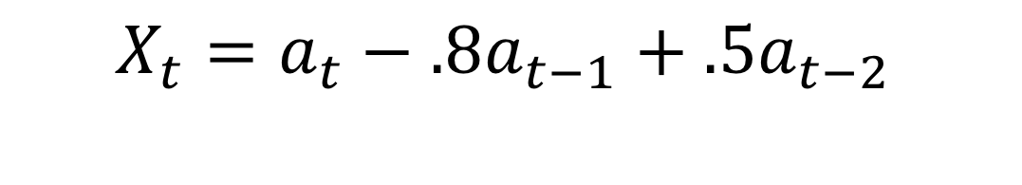
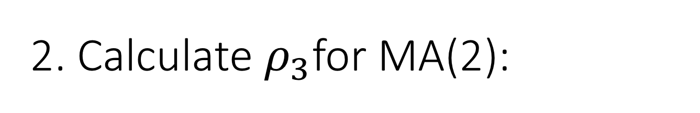
2. Calculate $ρ_{3}$for MA(2):
$$X_{t}=a_{t}−.8a_{t−1}+.5a_{t−2}$$

Slide 16
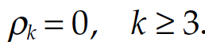
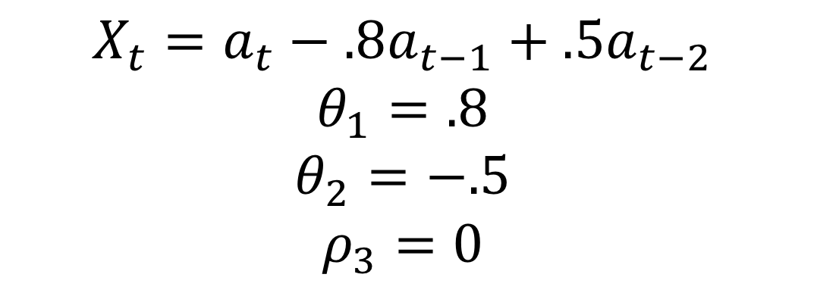
2. Calculate $ρ_{3}$for MA(2):
$$X_{t}=a_{t}−.8a_{t−1}+.5a_{t−2}$$
$$θ_{1}=.8$$
$$θ_{2}=−.5$$
$$ρ_{3}=0$$

Slide 17
Verify the autocorrelations using tswge

Slide 18
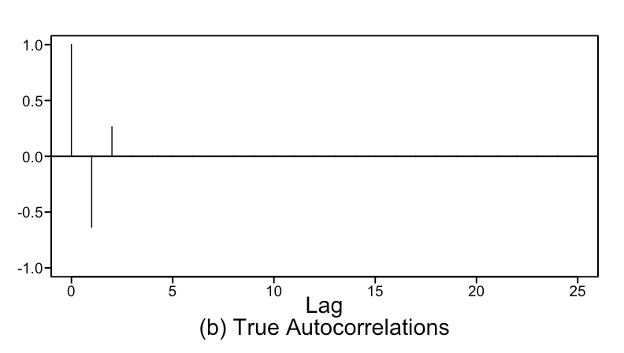
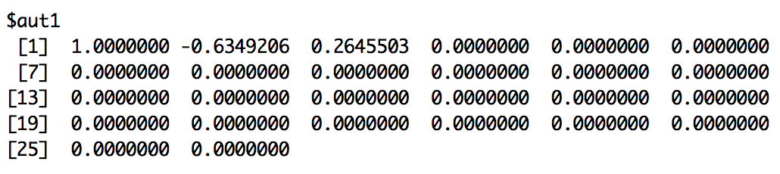
Verify the autocorrelations using tswge
plotts.true.wge(theta = c(.8,-.5))

Slide 19
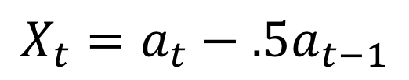
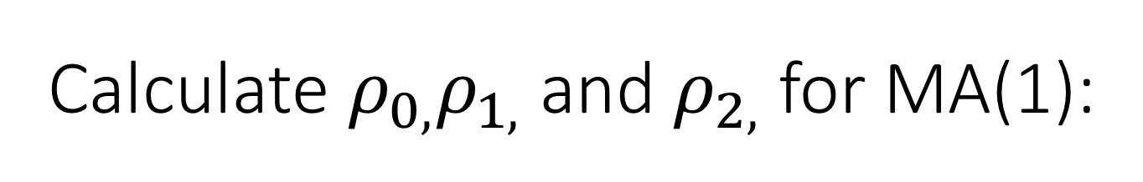
Calculate $ρ_{0,}ρ_{1,}$ and $ρ_{2,}$for MA(1):
$$X_{t}=a_{t}−.5a_{t−1}$$
We will use this result a bit later…. maybe write this one down on a scratch sheet of paper.

Slide 20
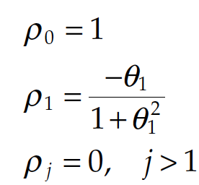
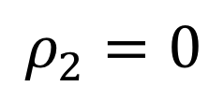
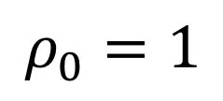
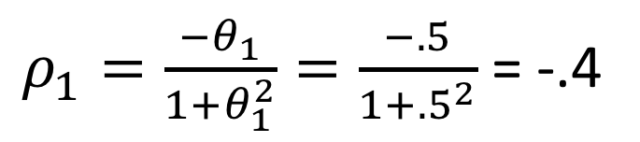
Calculate $ρ_{0,}ρ_{1,}$ and $ρ_{2,}$for MA(1):
$$X_{t}=a_{t}−.5a_{t−1}$$
$$ρ_{0}=1$$
$ρ_{1}=\frac{{−θ}_{1}}{1+θ_{1}^{2}}=\frac{−.5}{1+{.5}^{2}}$ = -.4
$$ρ_{2}=0$$
We will use this result a bit later…. maybe write this one down on a scratch sheet of paper.

Slide 21
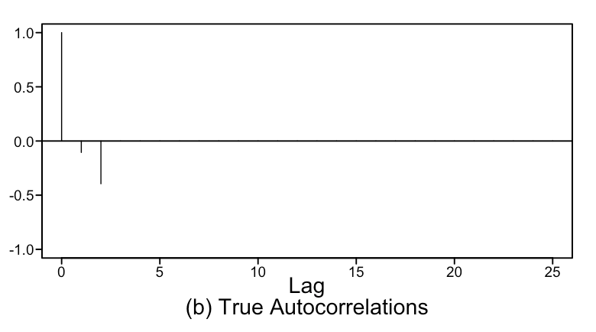
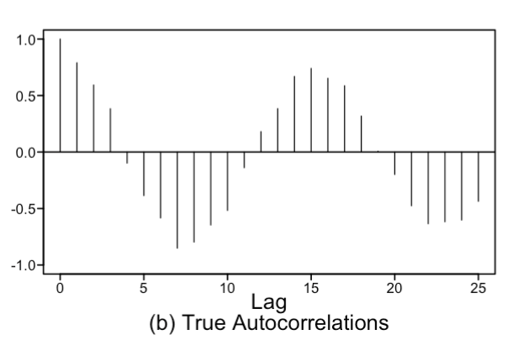
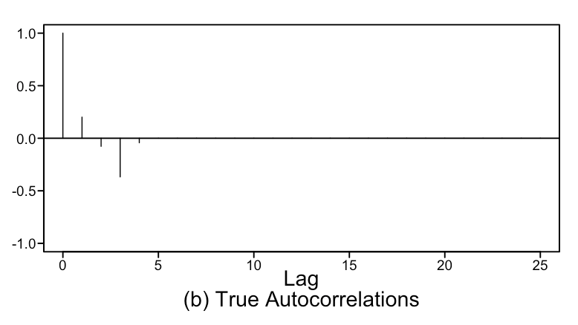
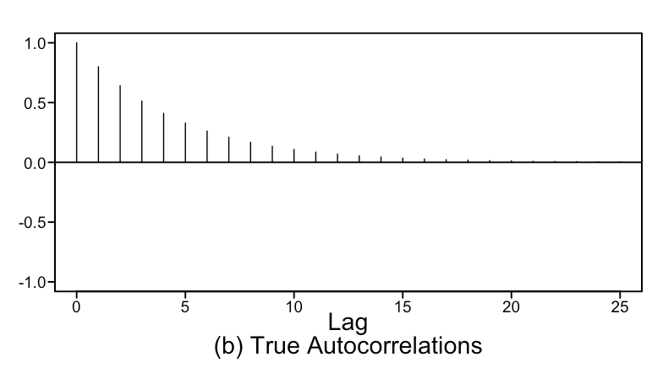
Matching: Without R / tswge
1. AR(1)
a
2. MA(2)
b
3. MA(4)
c
4. AR(4)
d

Slide 22
Matching: Without R / tswge
1. AR(1)
d
2. MA(2)
a
3. MA(4)
c
4. AR(4)
b

Slide 23
END Break Out 2

Slide 24
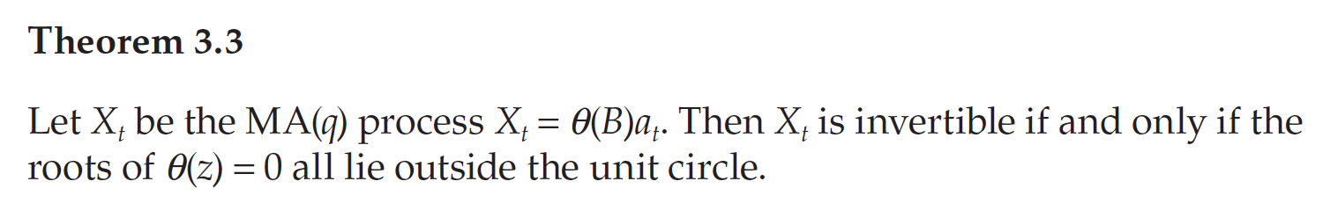
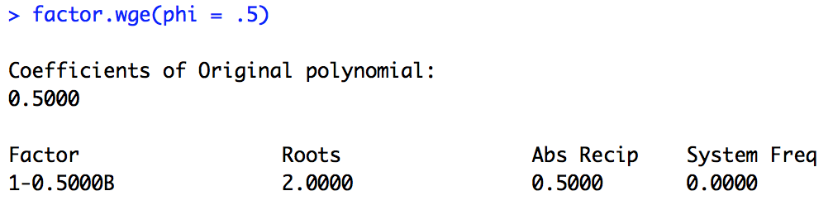
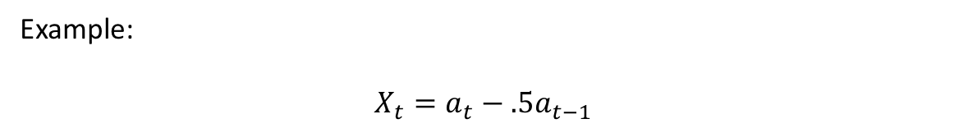
Review Invertible Models
Example:
$$X_{t}=a_{t}−.5a_{t−1}$$

Slide 25
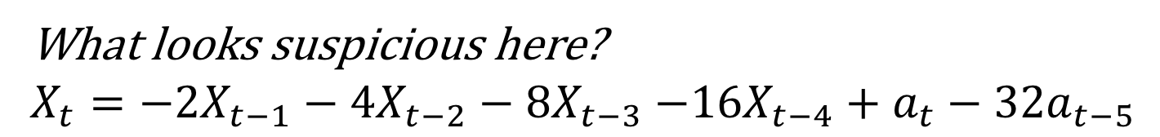
Discussion: Invertibility
What looks suspicious here?
$X_{t}=−2X_{t−1}−4X_{t−2}−8X_{t−3}$ $−16X_{t−4}+a_{t}−32a_{t−5}$

Slide 26
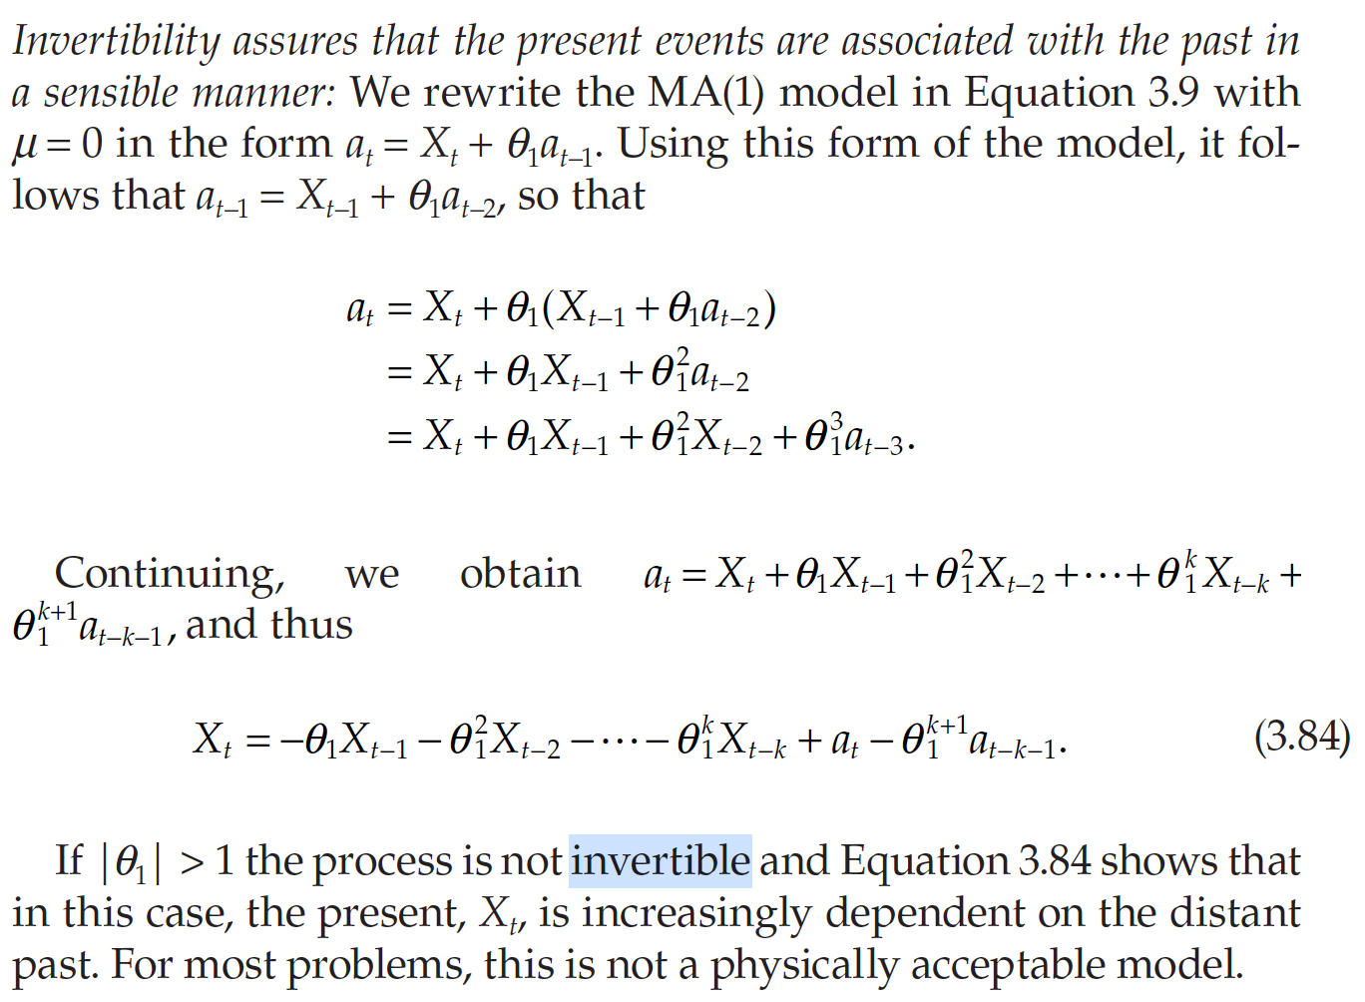
Why Only Consider Invertible Models?
pg. 132

Slide 27
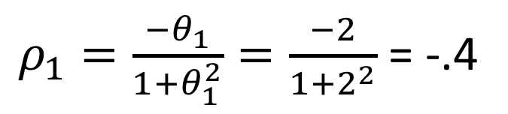
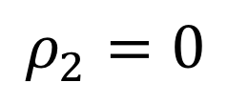
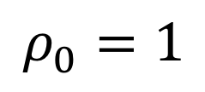
Discussion: Invertibility
What are the autocorrelations of : $X_{t}=a_{t}−2a_{t−1}$
$$ρ_{0}=1$$
$ρ_{1}=\frac{{−θ}_{1}}{1+θ_{1}^{2}}=\frac{−2}{1+2^{2}}$ = -.4
$$ρ_{2}=0$$

Slide 28
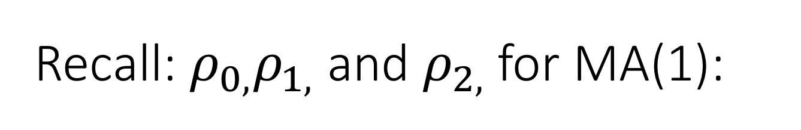
Recall: $ρ_{0,}ρ_{1,}$ and $ρ_{2,}$for MA(1):
$$X_{t}=a_{t}−.5a_{t−1}$$
$$ρ_{0}=1$$
$ρ_{1}=\frac{{−θ}_{1}}{1+θ_{1}^{2}}=\frac{−.5}{1+{.5}^{2}}$ = -.4
$$ρ_{2}=0$$
We will use this result a bit later…. maybe write this one down on a scratch sheet of paper.

Slide 29
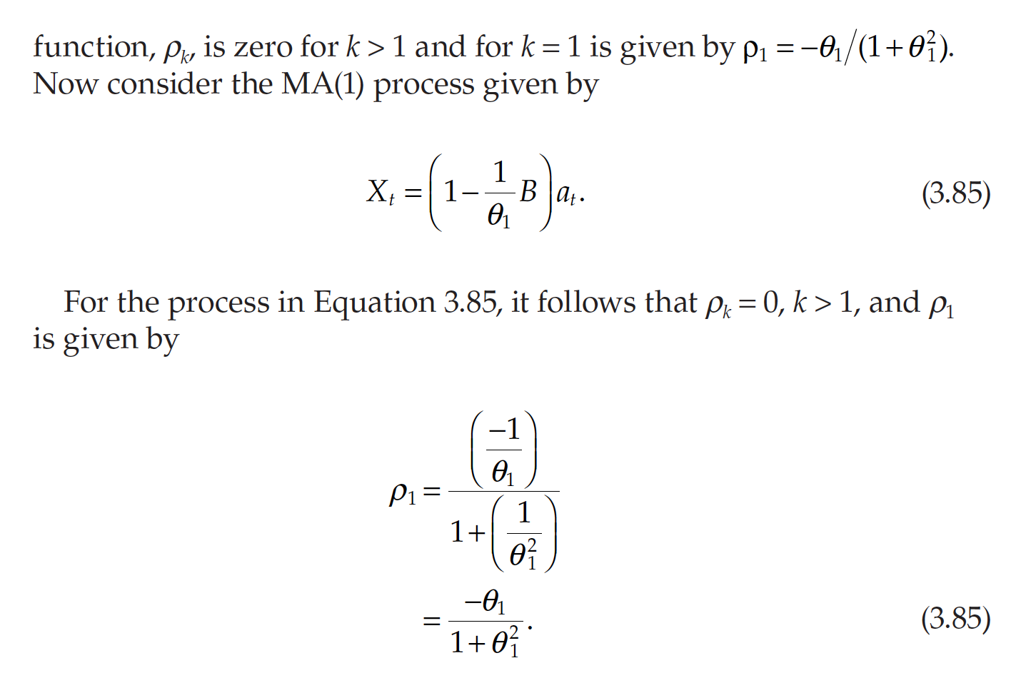
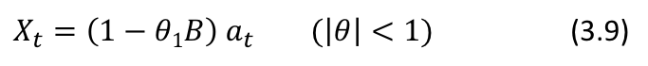
Why Only Consider Invertible Models?
$X_{t}=\left(1−θ1B\right)$ $a_{t} (\left|θ\right|<1)$ (3.9)
pg. 132

Slide 30
Break Out 3

Slide 31
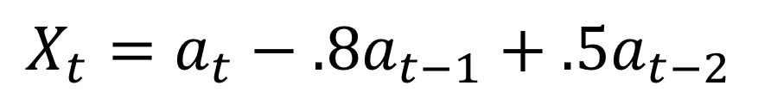
GLP Form for MA(2)
$$X_{t}=a_{t}−.8a_{t−1}+.5a_{t−2}$$

Slide 32
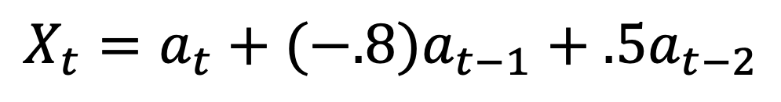
GLP Form for MA(2)
$$X_{t}=a_{t}+(−.8)a_{t−1}+.5a_{t−2}$$

Slide 33
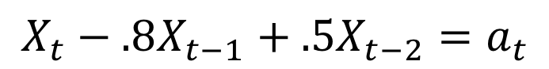
GLP Form for AR(2)
$$X_{t}−.8X_{t−1}+.5X_{t−2}=a_{t}$$

Slide 34
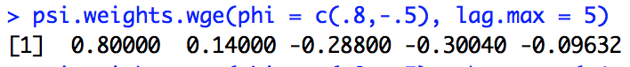
GLP Form for AR(2)
$$X_{t}−.8X_{t−1}+.5X_{t−2}=a_{t}$$
$$X_{t}≈a_{t}+.800a_{t−1}+.140a_{t−2}−.288a_{t−3}−.300a_{t−4}−.096a_{t−5}$$
*This could be infinite … these are just the first 5 terms (lag.max = 5).

Slide 35
GLP Form for ARMA(2,2)
$$X_{t}−.8X_{t−1}+.5X_{t−2}=a_{t}−.4a_{t−1}+.9a_{t−2}$$

Slide 36
GLP Form for ARMA(2,2)
$$X_{t}−.8X_{t−1}+.5X_{t−2}=a_{t}−.4a_{t−1}+.9a_{t−2}$$
$$X_{t}≈a_{t}+.400a_{t−1}+.720a_{t−2}+.376a_{t−3}−.059a_{t−4}−.235a_{t−5}$$
*This could be infinite … these are just the first 5 terms (lag.max = 5).

Slide 37
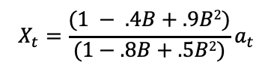
Psi Weights and Long Division
$$X_{t}−.8X_{t−1}+.5X_{t−2}=a_{t}−.4a_{t−1}+.9a_{t−2}$$
$${(1−.8B+.5B2)X}_{t}={(1 − .4B+.9B2)a}_{t}$$
$$X_{t}={\frac{(1 − .4B+.9B2)}{(1−.8B+.5B2)}a}_{t}$$

Slide 38
End Break Out 3

Slide 39
Break Out 4

Slide 40
ARMA MODELS
Compare and discuss the realizations from the ARMA model(s) you generated. Specifically comment and compare the ACFs and the Spectral Densities.

Slide 41
ARMA MODELS

Slide 42
Generate a realizations from an ARMA model. You pick p and q. Include the ACF and spectral density.
Excellent Example from a Student!
> plotts.true.wge(phi = c(.8, -.5))
Generating a ARMA(2,2) Model
> plotts.true.wge(phi = c(.8, -.5),theta = c(.4, -.9))
> plotts.true.wge(theta = c(.4, -.9))
As seen from graphs, the spectral density plot for ARMA(2,2) model is combination of spectral density plots for corresponding AR(2) and MA(2) models.

Slide 43
Generate a realizations from an ARMA model. You pick p and q. Include the ACF and spectral density.
Generating a ARMA(2,2) Model
> arma2_2 <- gen.arma.wge(500,phi = c(.8, -.5),theta = c(.4, -.9), sn = 999)
> plotts.sample.wge(arma2_2)
plotts.true.wge(phi = c(.8, -.5),theta = c(.4, -.9))

Slide 44
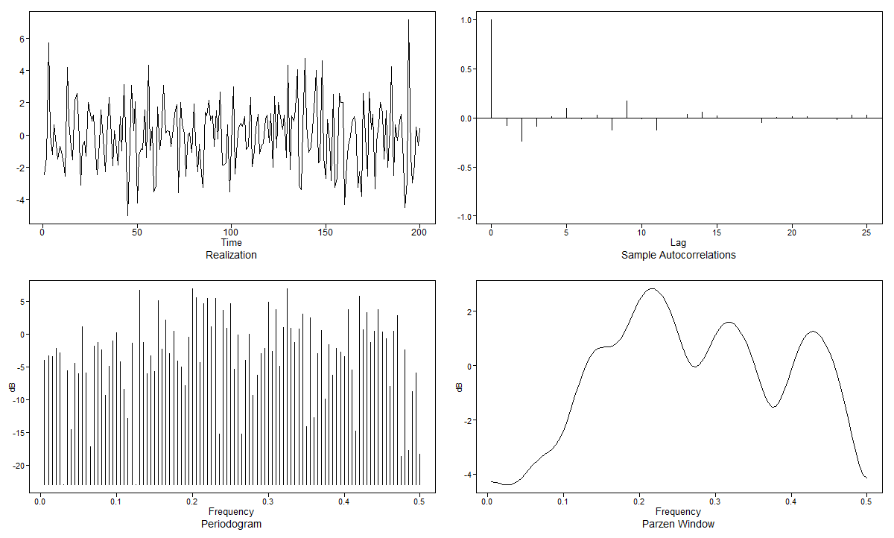


ARMA(2,2) Model Realizations (From a Student!)
Model: $X_{t}−0.3X_{t−1}+0.2X_{t−2}= a_{t}−2a_{t−1}−0.15a_{t−2}$
Realization 1:
Realization 2:
True:

Slide 45
Evaluate AIC for identifying model structure.
Generate 100 observations from an ARMA(1,1).
Use aic5.wge() to try and identify the model.
Now generate 500 observations from an ARMA(1,1)
use aic5.wge()to try and identify the model
How does aic5.wge() perform?
Repeat for an ARMA(p,q) where you select the p and q.

Slide 46
End Break Out 4

Slide 47
Break Out 5

Slide 48
SWA Cancellation Data
Discuss which of the 5 models from aic5.wge() you would favor most for this realization?

Slide 49

SWA Cancellation Data
AR(1)
MA(2)
AR(2)
ARMA(1,1)
MA(1)

Slide 50
End Break Out 5

Slide 51

Time Series Study!

Slide 52
Common Questions

Slide 53
COMMON QUESTIONS
Sec 5.2:
How is a MA(q) always stationary? Check out the proof … that is only way I know to show it. Condition one and two are easy to show, condition 3 takes a little more work. The details of the proof are in the book.
Why do the spectral densities have dips instead of peaks? Check out the proof … that is only way I know to show it.
However, it is because they have dips that they are helpful in an applied sense.
Sec 5.3:
Why are MA models defined as ARMA models in R? Just coders choice: MA(q) = ARMA(0,q)…. there is no statistical reason other than for convenience.
Sec 5.4:
Why is it undesirable to have 2 models with the same autocorrelation? For one thing, they will produce different forecasts.
Why do we not consider non-invertible models? We will cover this tonight. The model won’t make logical sense and the model multiplicity argument.
Sec 5.5:
For cases where we have cancellation, are there cases where it is appropriate to use the model we get as a result of cancellation instead? Can it make sense to ever use this more simplistic model?
DEFINITELY … AND YOU SHOULD.
Are non-ARMA models useful (ones that are not both stationary and invertible)? Definitely … we will cover some non-stationary models next. We will always only consider invertible models.
Sec 5.6:
Can you argue to use one model over another if their AICs are very close? Definitely ... and you should… in fact … they don’t even have to be very close. The AIC is just one metric. We will see an example tonight.
Sec 5.7:
Why does the output for psi.weight.wge start at psi 1? psi weights are coefficients of white noise terms in the GLP. The GLP is xt = at + psi_1a_t-1 + psi_2a_t-2 … psi_0 = 1 is what you are seeing and is the coefficient of a_t.

